Slide 1

6th Grade Math
Unit 12, Lesson 11 Solving One-Step Multiplication and Division Equations Using Diagrams Volume 2, pg. 340

Slide 2


Benchmark
MA.6.AR.2.3
Write and solve one-step equations in one variable within a mathematical or real-world context using multiplication and division, where all terms and solutions are integers.
volume 2, pg. 340

Slide 3
Integrated Mathematical Thinking and Reasoning Standards
MA.K12.MTR.1.1 Actively participate in effortful learning both individually and collectively.
MA.K12.MTR.2.1 Demonstrate understanding by representing problems in multiple ways.
MA.K12.MTR.4.1 Engage in discussions that reflect on the mathematical thinking of self and others.
MA.K12.MTR.5.1 Use patterns and structure to help understand and connect mathematical concepts.
volume 2, pg. 340

Slide 4

Learning Target
I can solve one-step multiplication and division equations using diagrams.
volume 2, pg. 340

Slide 5

Warm-Up
volume 2, pg. 340

Slide 6
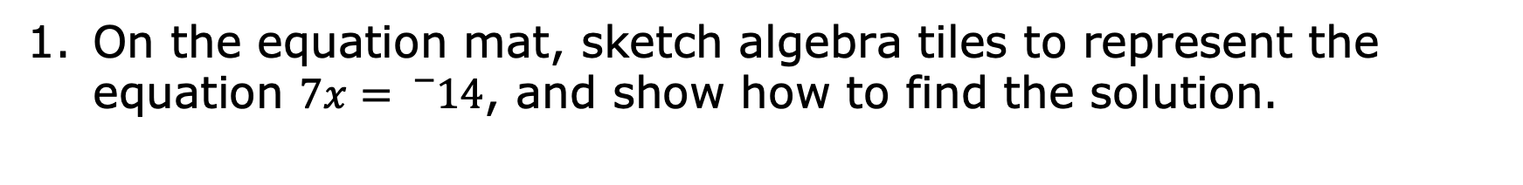
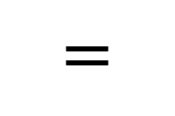
12.11.1 Warm-Up: Manipulative Math
volume 2, pg. 340

Slide 7

Exploration
volume 2, pg. 341

Slide 8
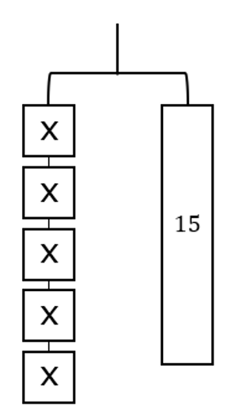
12.11.2 Exploration: Hanging Around Activity
The hanger diagram represents the equation 5𝑥 = 15.
volume 2, pg. 341

Slide 9
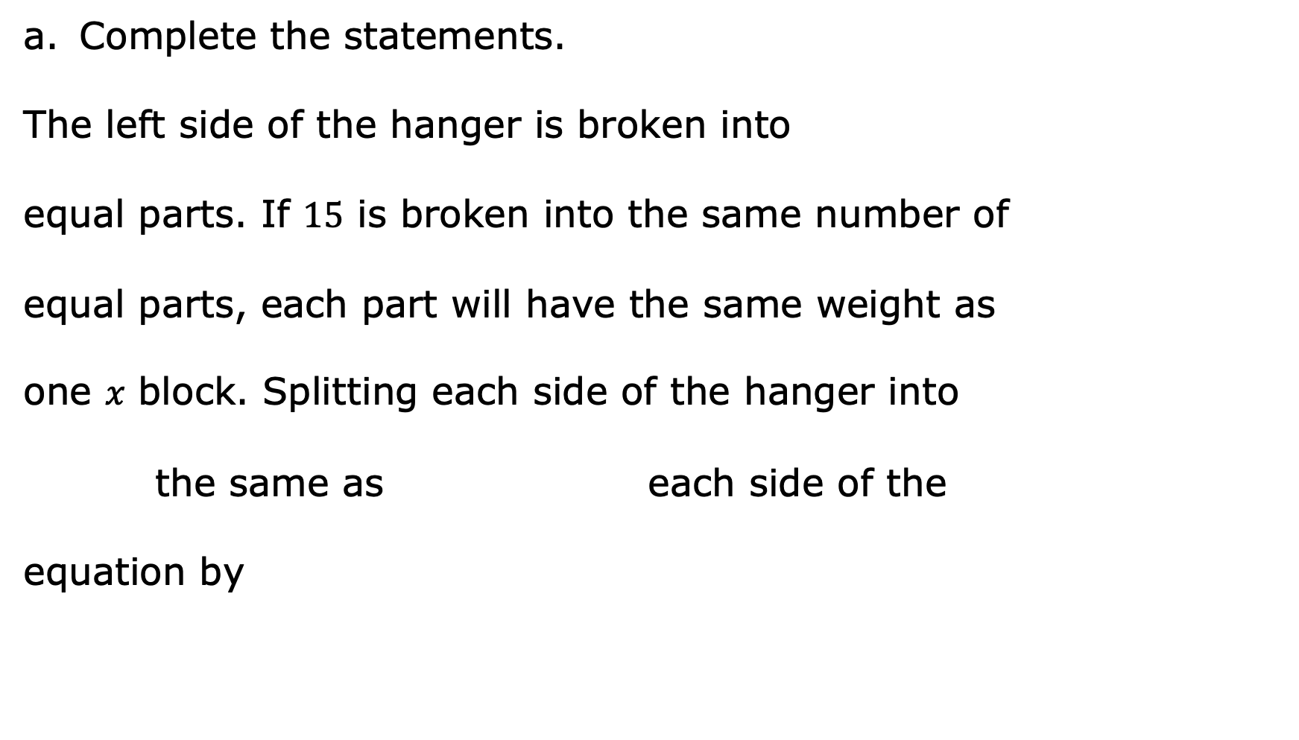
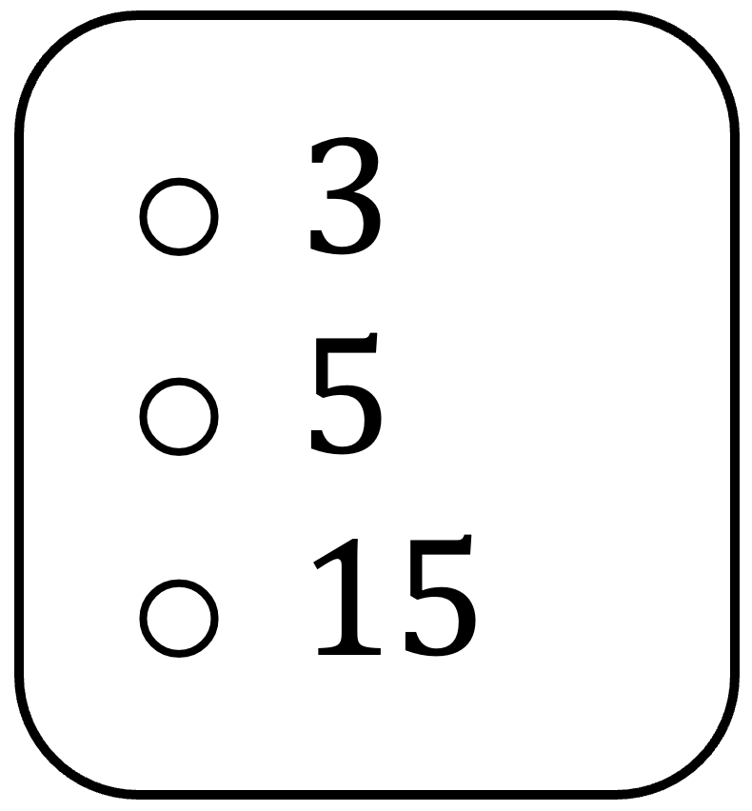
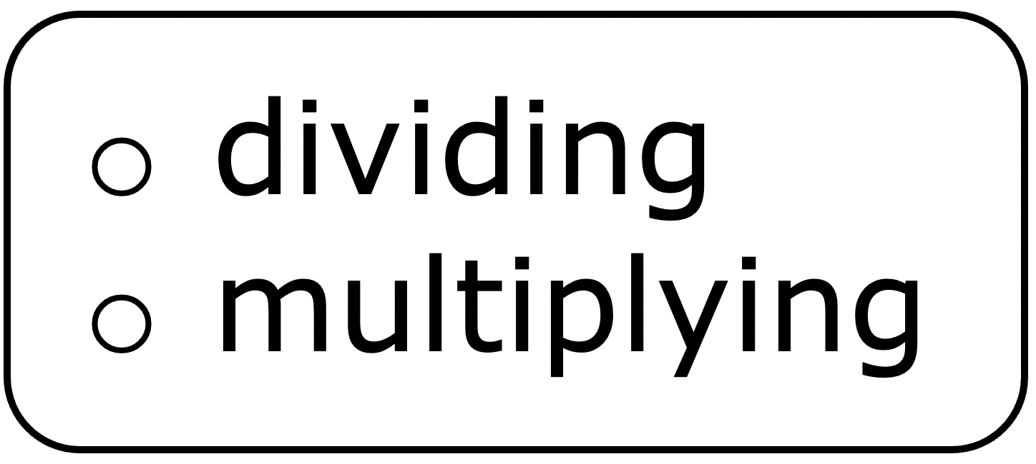

volume 2, pg. 341

Slide 10
Sketch splitting the hanger diagram into the equal parts as described in Part A.
What is the value of 𝑥?
volume 2, pg. 341

Slide 11
Compare your diagram with your partner. Discuss the similarities and differences.
Provide positive feedback to your partner in their book on their sketch and solution.
Partner Feedback
volume 2, pg. 341

Slide 12

Guided Instruction
volume 2, pg. 342

Slide 13
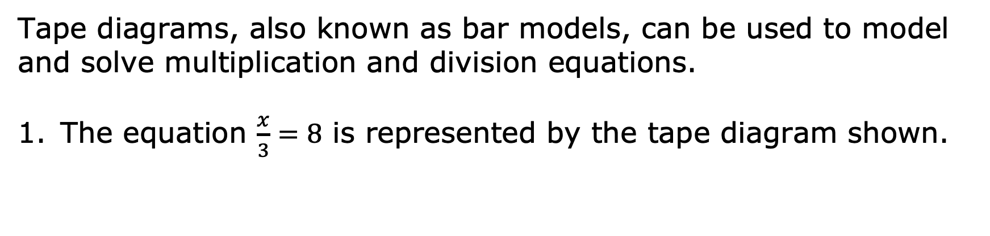

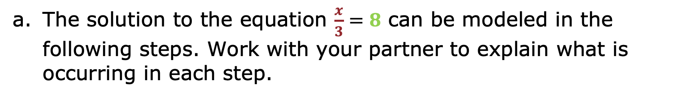
12.11.3 Guided Instruction: Solving One-Step Multiplication and Division Equations Using Diagrams
volume 2, pg. 342

Slide 14
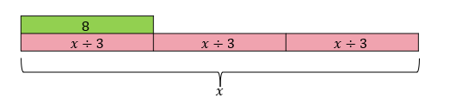
Step 1
Explanation of Step 1
volume 2, pg. 342

Slide 15
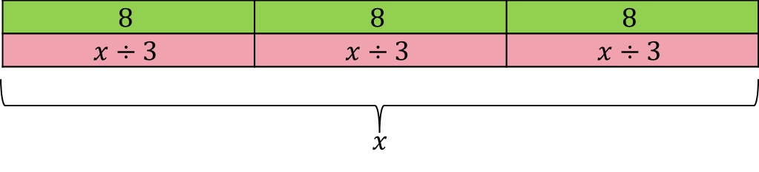
Step 2
Explanation of Step 2
volume 2, pg. 342

Slide 16

Step 3
Explanation of Step 3
volume 2, pg. 342

Slide 17
Discuss with your partner how the operation used in the equation relates to the operation used in the solution. Summarize your discussion.
volume 2, pg. 342

Slide 18


volume 2, pg. 343

Slide 19
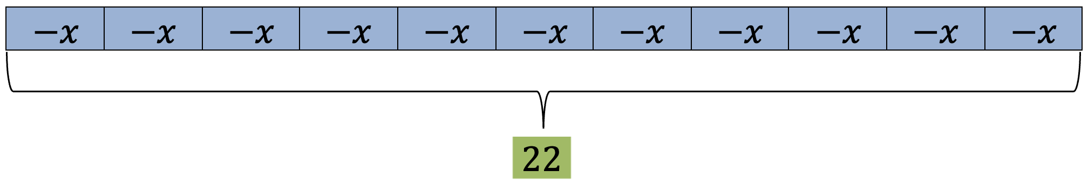
Step 1
How were the integers in the equation used to determine the negative value of 𝑥?
Explanation of Step 1
volume 2, pg. 343

Slide 20
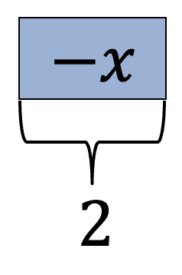
Step 2
Explanation of Step 2
volume 2, pg. 343

Slide 21
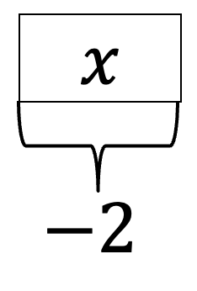
Step 3
Explanation of Step 3
volume 2, pg. 343

Slide 22
b. Discuss with your partner how the operation used in the equation relates to the operation used in the solution. Summarize your discussion.
volume 2, pg. 343

Slide 23

Collaboration
volume 2, pg. 344

Slide 24
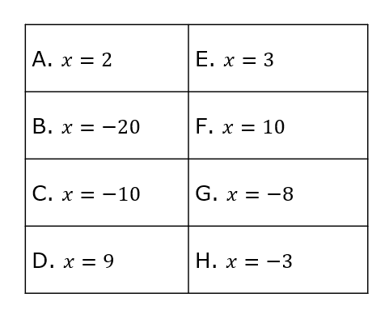
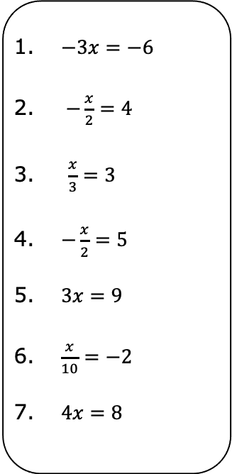
12.11.4 Collaboration: Matching Equations and Solutions
Match each equation to the correct solution. Record the equation with its solution in the table. Some solutions may be used more than once or not at all. Include an explanation for the match.
volume 2, pg. 344

Slide 25
Equation | Solution | Explanation for Match
volume 2, pg. 344

Slide 26

Your Turn
volume 2, pg. 345

Slide 27
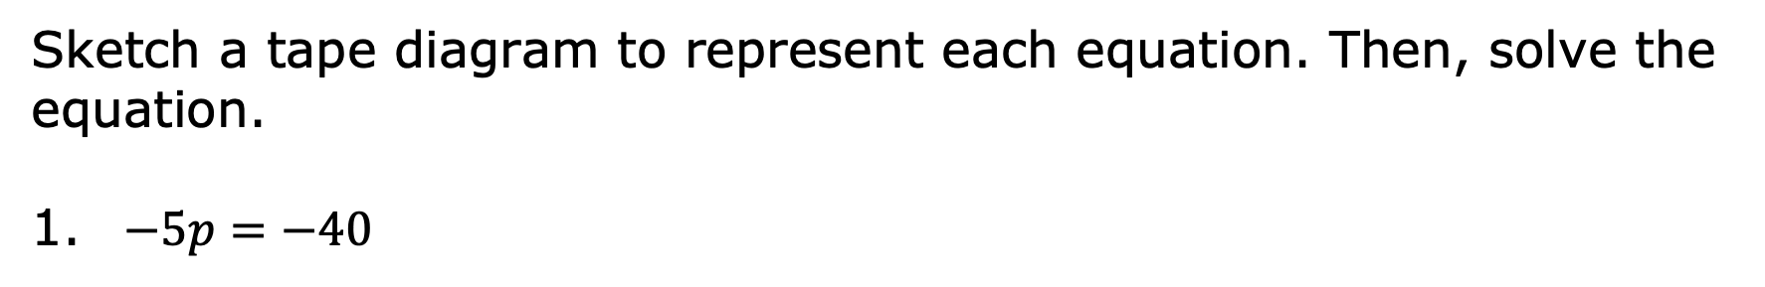
12.11.5 Your Turn!
volume 2, pg. 345

Slide 28
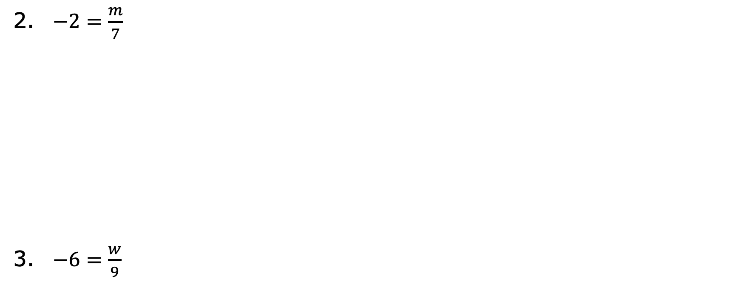
volume 2, pg. 345

Slide 29

Wrap-Up
volume 2, pg. 345

Slide 30
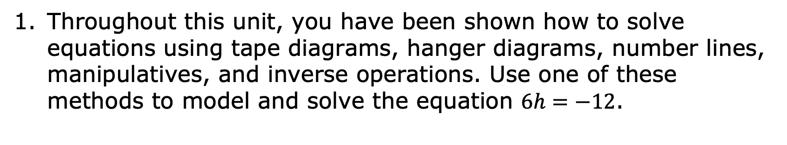
12.11.6 Wrap-Up: Ticket Out the Door
volume 2, pg. 345

